Slide 1
Biochem 3BP3 Beyond the Gene - Networks, Ontologies
“Literature is informative but is not information”
– Dr. Suzanna Lewis, Lawrence Berkeley National Laboratory
“Messiness of biology subverts general solutions”
– Dr. Patricia Babbitt, California Institute for Quantitative Biosciences

Slide 2
Integrating Knowledge
We have sequenced a large number of diverse genomes, each with thousands of predicted genes
We have performed genome-wide gene expression or gene knock-down experiments to understand the role of these genes
High-throughput experimental methods are producing increasingly complex data sets about the interactions between genes
We have a century of knowledge about molecular & cell biology, physiology, biochemistry, etc. Yet publications rates are increasing!
How do we integrate these data to obtain a deeper understanding of biology?
How do we interpret experiments that generate thousands or millions of data points?

Slide 3
Integrating Knowledge
“Literature is informative but is not information”
– Dr. Suzanna Lewis, Lawrence Berkeley National Laboratory
The scientific literature and the peer-reviewed publication system that drives it is at the heart of scientific advancement
Transparency, repeatability, and readability are important aspects of scientific publishing
A good scientific publication is highly informative – to a human reader – but very hard for a computer to work with
To a computer scientist, information is “bits” organized via strict rules –good digital representations of knowledge

Slide 4
Integrating Knowledge
Knowledge integration in the biological sciences has two “consumers”
Humans – databases and data sets that provide a ‘one stop shop’ for integrated knowledge since no single person can keep up with the literature
Computers – databases and data sets that provide integration of knowledge in a form that computer algorithms can use to make sense of new data
Key to knowledge integration is the task of ‘Biocuration’ – translation of scientific knowledge into a digital format
Two key tools of Biocuration are Ontologies and Networks
Raw uncurated data equally valuable in the form of Interactomes

Slide 5
Ontologies
Also known as “Controlled Vocabularies” – standardized names and relationships to be used in the description of biological concepts
Ontologies do not contain data but instead are conceptual and map the relationships between concepts
Data can be tagged with ontological terms, thus placing the data within a larger conceptual framework plus allowing comparison among data sets
Computer algorithms see ontologies as graphs they can traverse to answer questions about data
The most heavily adopted ontology is the Gene Ontology
represents gene and gene product information among all species
focused upon Molecular Function, Cellular Component, and Biological Process

Slide 6
CYP1A1 Annotated by the Gene Ontology

Slide 7
CYP1A1 Annotated by the Gene Ontology

Slide 8
“Iron Ion Binding” Gene Ontology term
An ontology term has an Accession, Name, and Definition as it’s minimum information
Terms often include references to external information, such as a citation from the scientific literature
External data can be linked to the term by analysis (e.g. gene annotation algorithms, Pfam analysis, etc) <- not part of the ontology itself

Slide 9
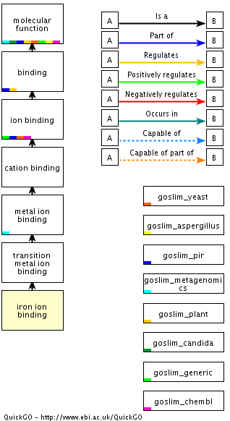
“Iron Ion Binding” Ontological Relationships
Each ontology term is connected to other ontology terms via carefully defined relationship types
“is_a” and “part_of” are the most common relationship types but each ontology may have its own specific types
Tagging data with ontology terms allows researchers to search or classify their data using specific or general terms
Ontologies can help researchers discover unrealized relationships among results

Slide 10
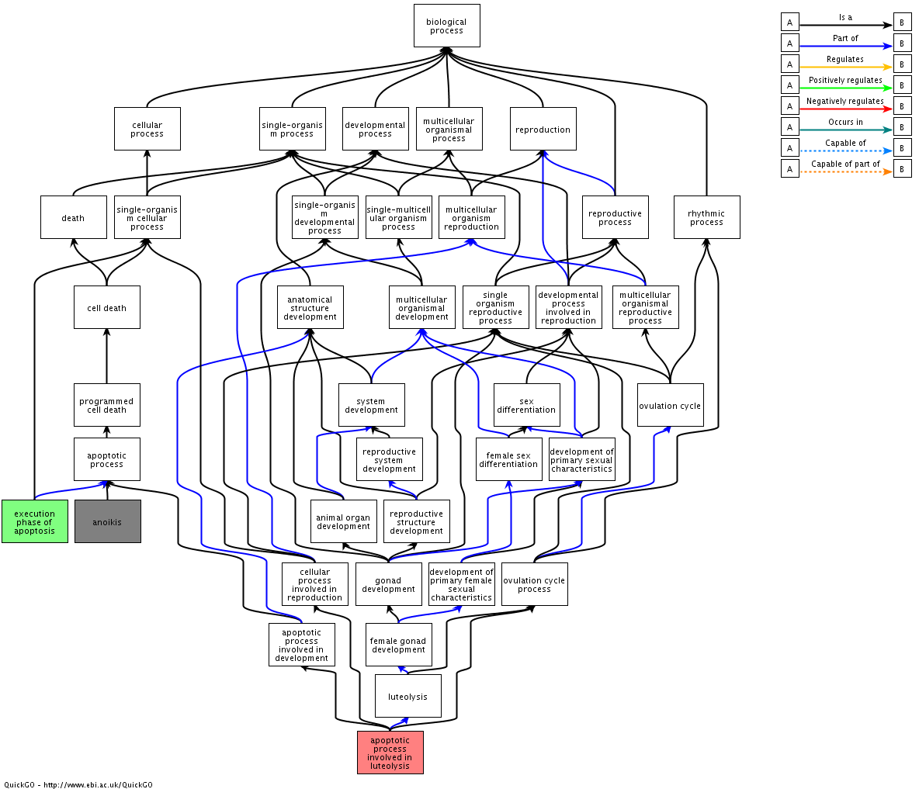
Example – Gene annotation highlighted three GO Terms in a data set (in colour) but the Gene Ontology shows how they are linked by common biological processes

Slide 11
OBO & OWL formats
Computer readable descriptions of an ontology allow development of algorithms to perform analysis in an ontological context

Slide 12
OBO Foundry
www.obofoundry.org - a repository of thousands of ontologies, each developed by ‘domain experts’, i.e. Biocurators with expert knowledge
Andrew’s lab are ‘domain experts’ in Antibiotic Resistance and have developed the Antibiotic Resistance Ontology

Slide 13
OBO Foundry
Enforces standards – particularly for syntax and relationship types – defined by Principles (three shown below)
Principle #1 – OPEN - Available to all without constraint, preferably using a Creative Commons license.
Principle #2 – FORMAT – Ontologies must be available in a common format language using standard syntax – OWL or OBO.
Principle #3 – ORTHOGONAL – terms must be unique – no duplicate terms among ontologies (i.e. a beta-lactamase GO term and a beta-lactamase ARO term). Where ontologies overlap, they use the exact same term (i.e. the ARO and GO both cite the GO term for beta-lactamase). This creates interconnectedness among ontologies!
There is often conflict in ontology development between ‘correctness’ and ‘usefulness’ - see Goble & Wroe. 2004. The Montagues and the Capulets. Comp Funct Genomics 5: 623-32.

Slide 14


Slide 15
Networks
Whereas ontologies map relationships between concepts, networks generally map relationships between real entities that can be measured
Unlike ontologies, networks are generally not hierarchical in nature
The best examples of a familiar network are a biochemical reaction or a regulatory pathway
The most commonly used network resource is the KEGG: Kyoto Encyclopedia of Genes and Genomes
Networks reflect a synthesis of knowledge, particularly around gene regulation and biochemical reactions

Slide 16
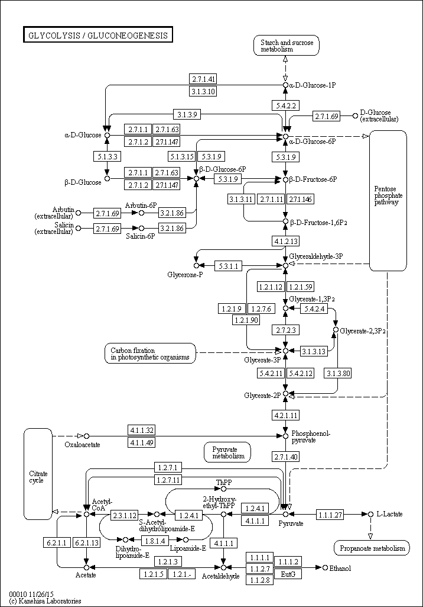
Glycolysis in KEGG
The glycolysis network in KEGG represents understood relationships among enzymes and compounds
Each enzyme or compound “term” is associated with a large volume of curated information on its classification, association with disease, role in the cell, etc.
Networks like KEGG are useful for either learning about a pathway or annotating / analyzing data in the context of a pathway
KEGG includes computer-readable data formats

Slide 17
Interactomes
Whereas networks & ontologies reflect a synthesis of knowledge, they do not integrate raw experimental data, i.e. data that can lead to new knowledge
Interactomes reflect raw data from single experiments or integration of raw data from multiple experiments – they are not curated knowledge, they are experimental observations!
Interactomes track “interactions” between two entities. Examples:
compound – protein interaction
protein – protein interaction
compound – gene expression interaction
While the interaction has been observed, often the mechanism or the biological importance is not understood – a focus of Systems Biology

Slide 18
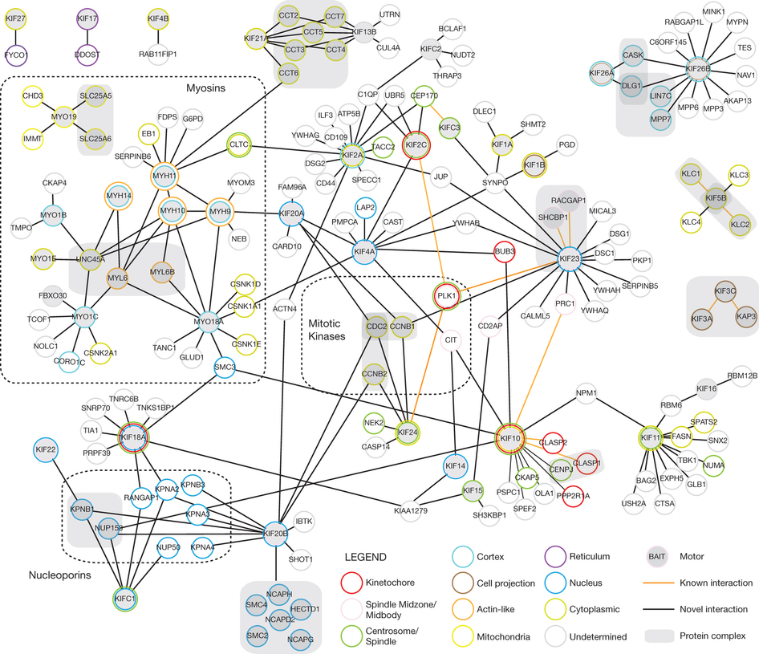
A genomic toolkit to investigate kinesin and myosin motor function in cells. Maliga et al. 2013. Nature Cell Biology 15: 325-334
191 candidate protein–protein interactions measured by affinity-purification mass spectrometry
Nodes (circles) = proteins; shaded gray for known motor proteins
Edges (line) = interactions; shaded black if previously unknown
Nodes are coloured by localization

Slide 19
Data Formats & Software
Interactome data can be stored in a number of formats (SIF, NNF, XGMML, SBML, etc.)
There are a number of domain specific repositories but not one centralized repository – data files often provided as supplementary files with a scientific publication
Data repositories and the role of publishers in ensuring scientific data is accessible and not lost over time is a very active discussion in the scientific community, e.g. GigaScience Journal, www.gigasciencejournal.com

Slide 20
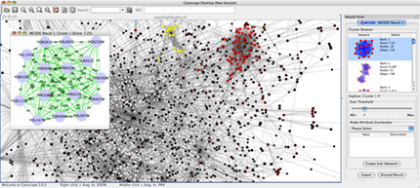
Data Formats & Software
The most popular software for analysis of interactome data is Cytoscape, www.cytoscape.org
Cytoscape allows interactome mining and visualization but also analysis of outside data (e.g. RNA-Seq) in the context of observed interactomes
e.g. are the genes upregulated in my RNA-Seq experiment reflective of a specific sub-set of protein-protein interactions?

Slide 22
Connections & Cross-References
Connections & Cross-References lead to standardization & normalization
Standardization – a common language is used to describe biological phenomena
Normalization – data, models, citations, and algorithms are annotated using the same common language, allowing easier sharing and comparison of data
Connections & Cross-Reference combined with computer-readable representations leads to powerful analytical tools
Examples
A protein-protein interactome dataset uses GenBank accessions for all the proteins observed
Gene Ontology annotates GenBank so all protein GenBank accessions are associated with GO terms
InterPro curates connections between Pfam and PROSITE models and Gene Ontology terms

Slide 23
Enrichment
A powerful tool for high-level interpretation of complex experimental data, allowing investigator to detect biological processes otherwise not apparent
Computational and statistical in nature – uses ontologies, networks, or interactomes to test if a specific biological process, pathway, or interaction is highlighted by the data
Null hypothesis – no ontological term, biochemical or regulatory network, or known interactions are over-represented in my data (relative to controls or background signal)

Slide 24
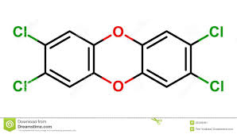
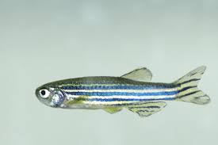
Enrichment Example:
1300 genes up-regulated in response to dioxin
CONTROL
RNA-Seq
dioxin
versus
EXPOSED
Danio rerio
All genes in the genome
Gene Ontology
enrichment analysis
GO terms for oxidative stress response, DNA damage repair statistically enriched in the up-regulated genes

Slide 25
Enrichment Example:
1300 genes up-regulated in response to dioxin
CONTROL
RNA-Seq
dioxin
versus
EXPOSED
Danio rerio
All genes in the genome
Each gene tagged with a different set of ontology terms in the genome annotation
Gene Ontology
enrichment analysis
Algorithm traverses the entire ontology to determine which higher-level ontology terms are involved in enrichment
GO terms for oxidative stress response, DNA damage repair statistically enriched in the up-regulated genes

Slide 26
Enrichment Example - KEGG
Purple – enzyme in cotton but not differentially regulated
Blue – downregulated
Red - upregulated
Bowman et al. 2013. RNA-Seq Transcriptome Profiling of Upland Cotton (Gossypium hirsutum L.) Root Tissue under Water-Deficit Stress. PLoS ONE 8(12):e82634

Slide 27
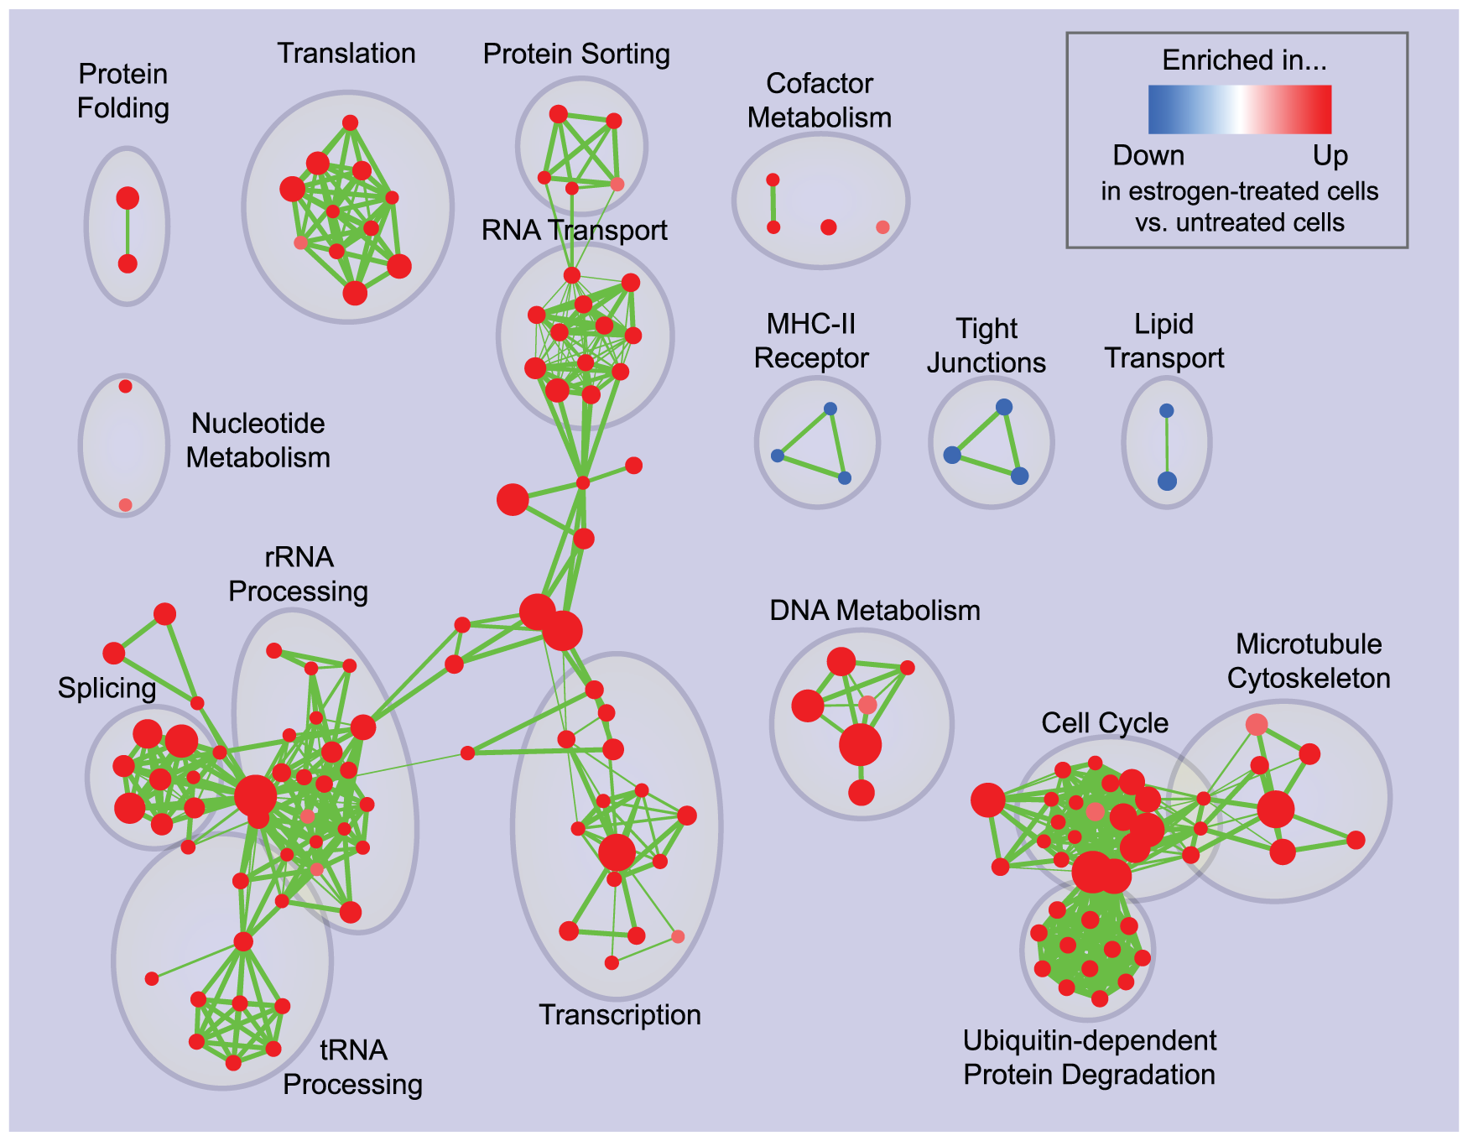
Enrichment Example - Interactomes
Enrichment map for estrogen treatment of breast cancer cells at 24 hours of culture.
Gene expression with estrogen treatment examined
Down- and upregulated genes examined in the context of known protein and other interactions
Merico et al. 2010. Enrichment Map: A Network-Based Method for Gene-Set Enrichment Visualization and Interpretation. PLoS One 5(11):e13984.

Slide 28
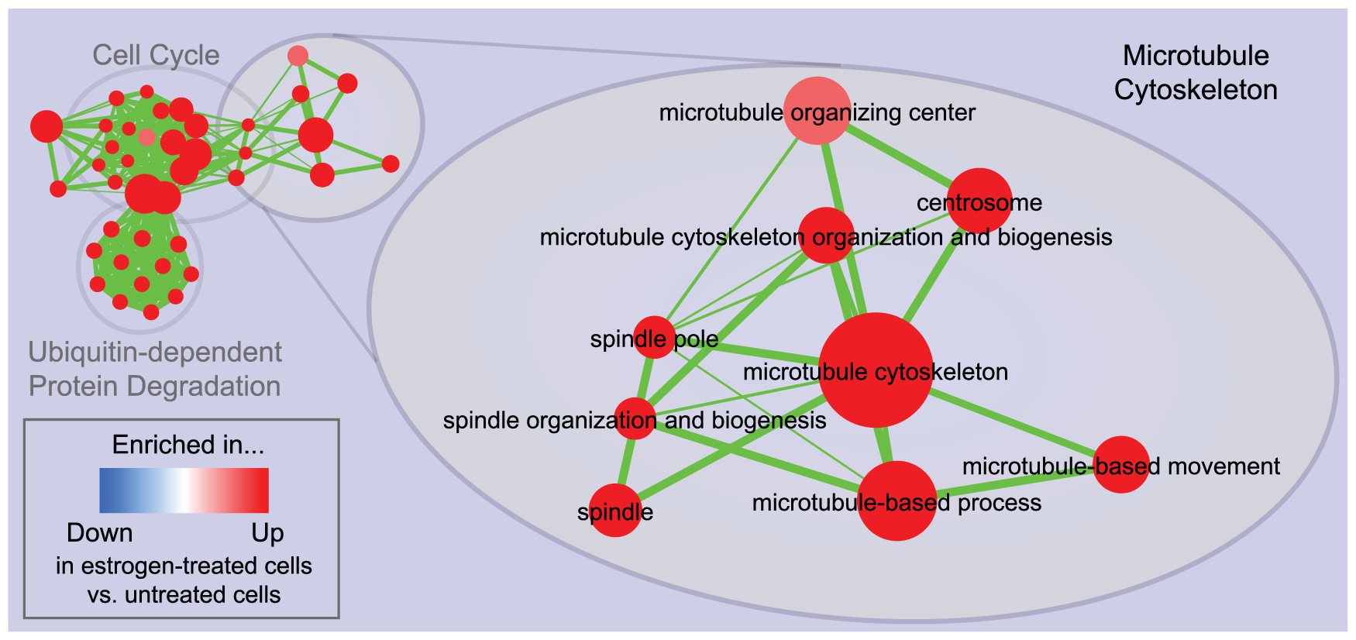
Enrichment Example - Interactomes
Enrichment map for estrogen treatment of breast cancer cells at 24 hours of culture.
Cell cycle & microtubule cytoskeleton genes and processes are up-regulated at the transcript level – can this help guide drug discovery?
Merico et al. 2010. Enrichment Map: A Network-Based Method for Gene-Set Enrichment Visualization and Interpretation. PLoS One 5(11):e13984.

Slide 30
Enrichment – Fisher’s Exact Test
Example: In human genome background (30,000 gene total), 40 genes are involved in p53 signaling pathway. A given gene list has found that 3 out of 300 belong to p53 signaling pathway. We ask the question if 3/300 is more than random chance comparing to the human background of 40/30000.
Null Hypothesis: the gene list is specifically associated (enriched) in the p53 signaling pathway no more than random chance.
Fisher Exact p-value = 0.008. Since p<0.05 the gene list is specifically associated (enriched) in the p53 signaling pathway more than random chance.
 | Gene List | Genome
p53 pathway | 3 | 40
not p53 pathway | 297 | 29960

Slide 31
Enrichment – EASE
The Fisher Exact test is sensitive to the inter-relationship of ontology terms and thus tends to over-predict.
DAVID’s EASE statistic is a modified Fisher Exact test that requires more genes as evidence of an enriched ontology term:
EASE p-value = 0.06. Since p>0.05 the gene list is not associated (enriched) in the p53 signaling pathway more than random chance.
 | Gene List | Genome
p53 pathway | 3-1 | 40
not p53 pathway | 297 | 29960

Slide 32
Comprehensive Antibiotic Resistance Database
Integrates ontologies, sequence similarity models, and genome annotation algorithms to predict resistome and antibiogram for pathogens
Resistome – the complement of resistance genes in a pathogen
Antibiogram – the range of drug resistance and susceptibility in a pathogen
All data and algorithms organized by the Antibiotic Resistance Ontology
We will be working with the latest version in the lab

Slide 33
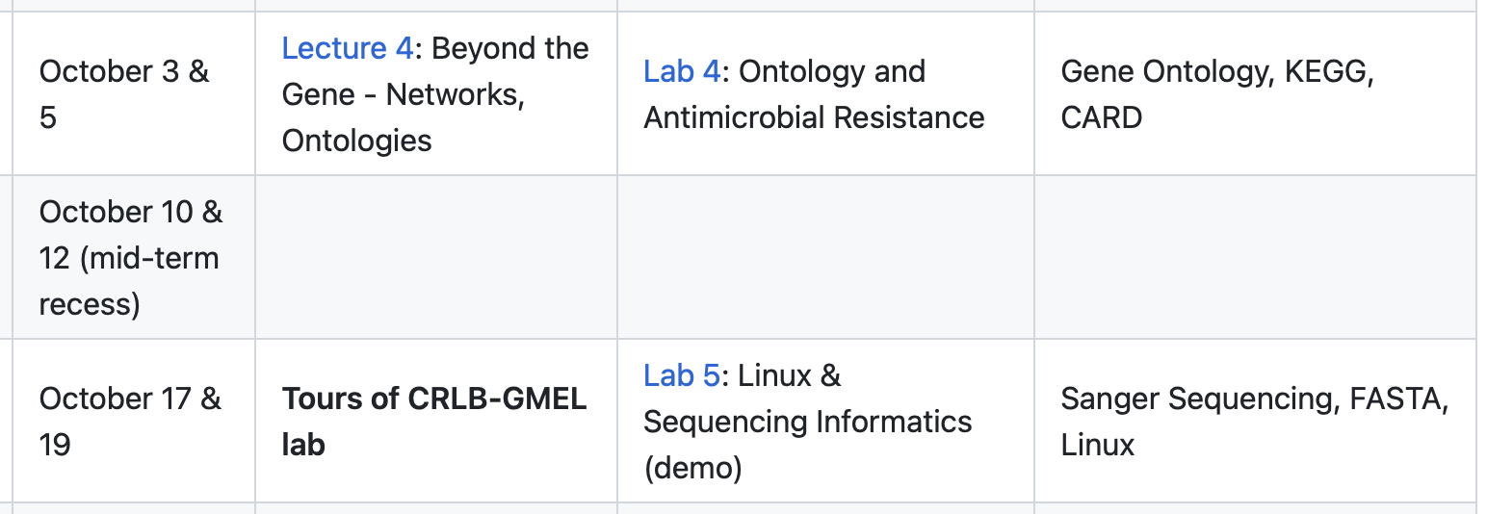
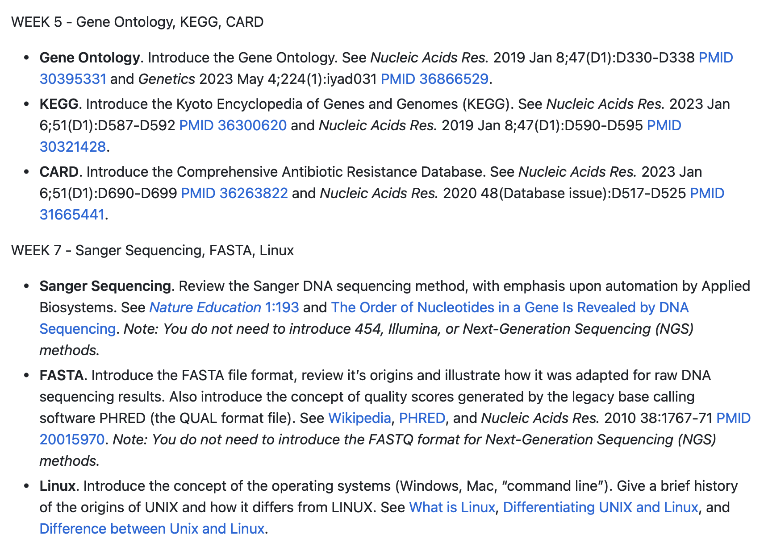
Next 3 weeks...

